Slide 1
Topic: Equation of a Straight Line.
EQ: How do we find the Equation of a Straight Line.

Slide 2
Gradient of a line
The Gradient measures the “rise or increase in y” and “run or increase in x” of the stairs beneath or above the line.
4
4

Slide 3

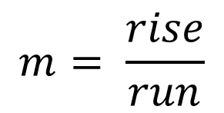
Gradient of a line (m)
To find the gradient, use the formula
4
$$m= \frac{rise}{run}$$
4
$m= \frac{4}{4}=$1

Slide 4
Topic: Equation of a Straight Line.
EQ: How do we find the Equation of a Straight Line.
To find the equation of any straight line we require to know 2 things:
(1) The gradient of the line.
(2) The y - intercept of the line (where the line crosses the y-axis)
The equation of a straight line is :
y = mx + c
gradient
y-intercept

Slide 5



y=mx + c
8
7
6
5
4
y intercept = 2
Rise = +1
2
3
2
1
Run = 2
$$\frac{1}{2}$$
-1
m = $\frac{Rise}{Run2}$ $= \frac{1}{2}$
-2
-3
-4
-5
So y= $\frac{1}{2}$x + 2
-6
-7
-8

Slide 6



y=mx + c
8
7
6
5
4
y intercept = 1
Rise = +3
1
3
2
1
Run = 4
$$\frac{3}{4}$$
-1
m = $\frac{Rise}{Run}$ $= \frac{3}{4}$
-2
-3
-4
-5
So y= $\frac{3}{4}$x + 1
-6
-7
-8

Slide 7



y=m x + c
8
7
6
5
4
y intercept = 3
Rise = -1
3
3
2
1
Run = 2
$$−\frac{1}{2}$$
-1
m = $\frac{Rise}{Run}$ $= \frac{−1}{2}$
-2
-3
-4
-5
So y=$−\frac{1}{2}$x + 3
-6
-7
-8

Slide 8
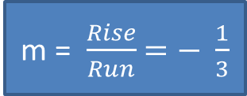


y=m x + c
8
7
6
5
4
y intercept = 4
Rise = -1
4
3
2
1
Run = 3
$$−\frac{1}{3}$$
-1
m = $\frac{Rise}{Run}$ $=− \frac{1}{3}$
-2
-3
-4
-5
-6
So y=$−\frac{1}{3}$x + 4
-7
-8

Slide 9
Practice time. Complete the worksheet

